Slide 1
Canada Aviation Solutions
By John Rey Quidet

Slide 2
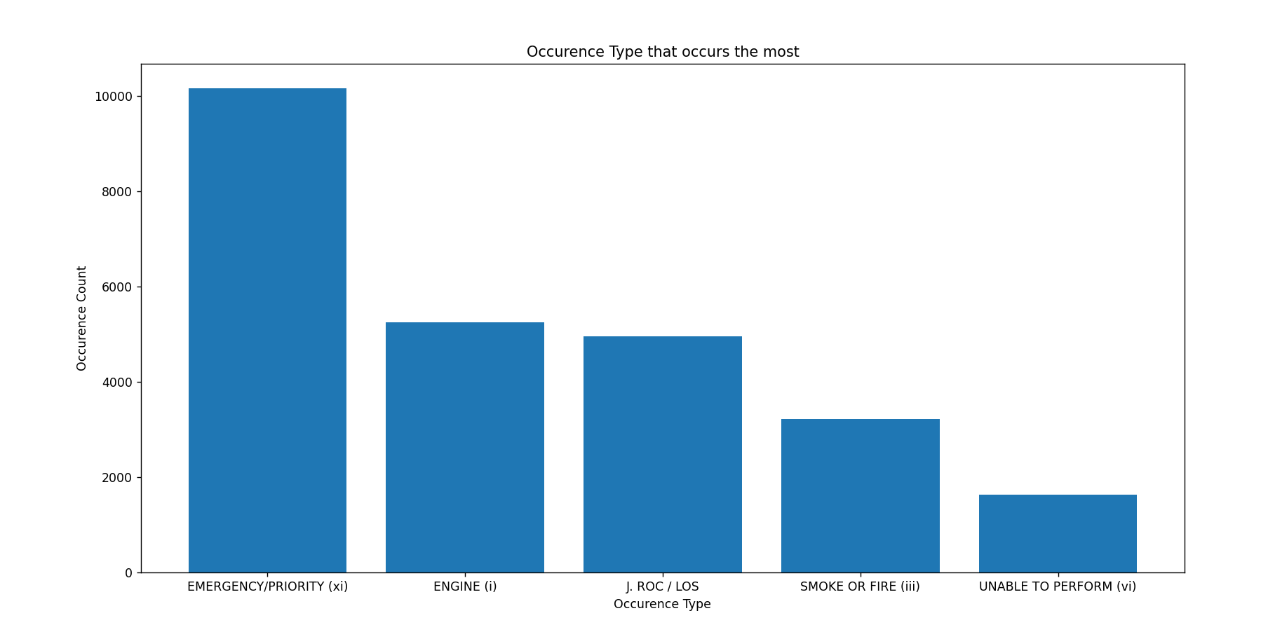
Just over 10, 000 of occurrences from 2025 to 2026 are from the EMERGENCY/PRIORITY type

Slide 3
What is Emergency/Priority?
Emergency - Involves immediate top priority handling of aircraft facing things such as “Mayday” (distress, grave/ imminent danger) or “Pan-Pan” (urgency) situations both repeated three times.

Slide 4
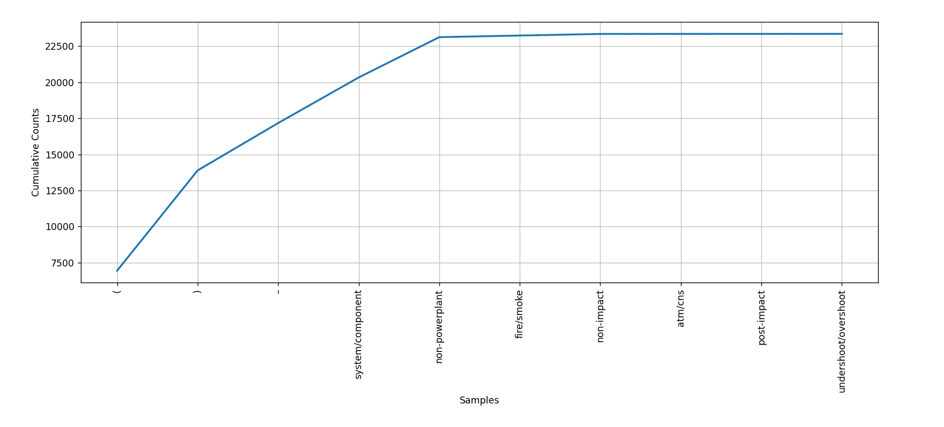

Slide 5
Natural Langugage Processing Reports
Used Natural Language Processing to check out the type Emergency/Priority occurred
Found that overshoot/undershoot, fire/smoke, atm/cns, non-powerplant, and system/component
Post-impact and non impact are one of the most occurring words but not an Emergency/Priority type more of a result of an occurrence
Same with those symbols (obviously)

Slide 6
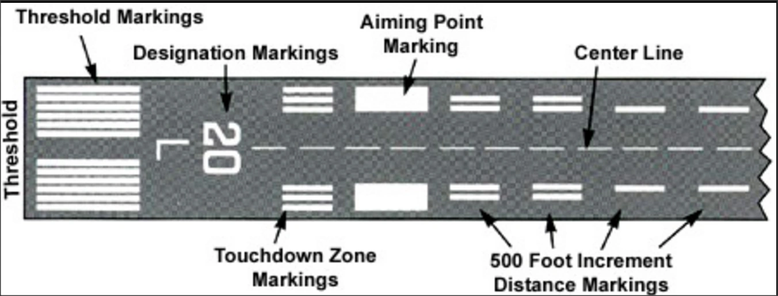
Overshoot/Undershoot
Undershoot - landing before the runway specifically on the designated runway touchzone(runway excursion)
Overshoot - landing past the runway specifically on the designated runway touchzone

Slide 7
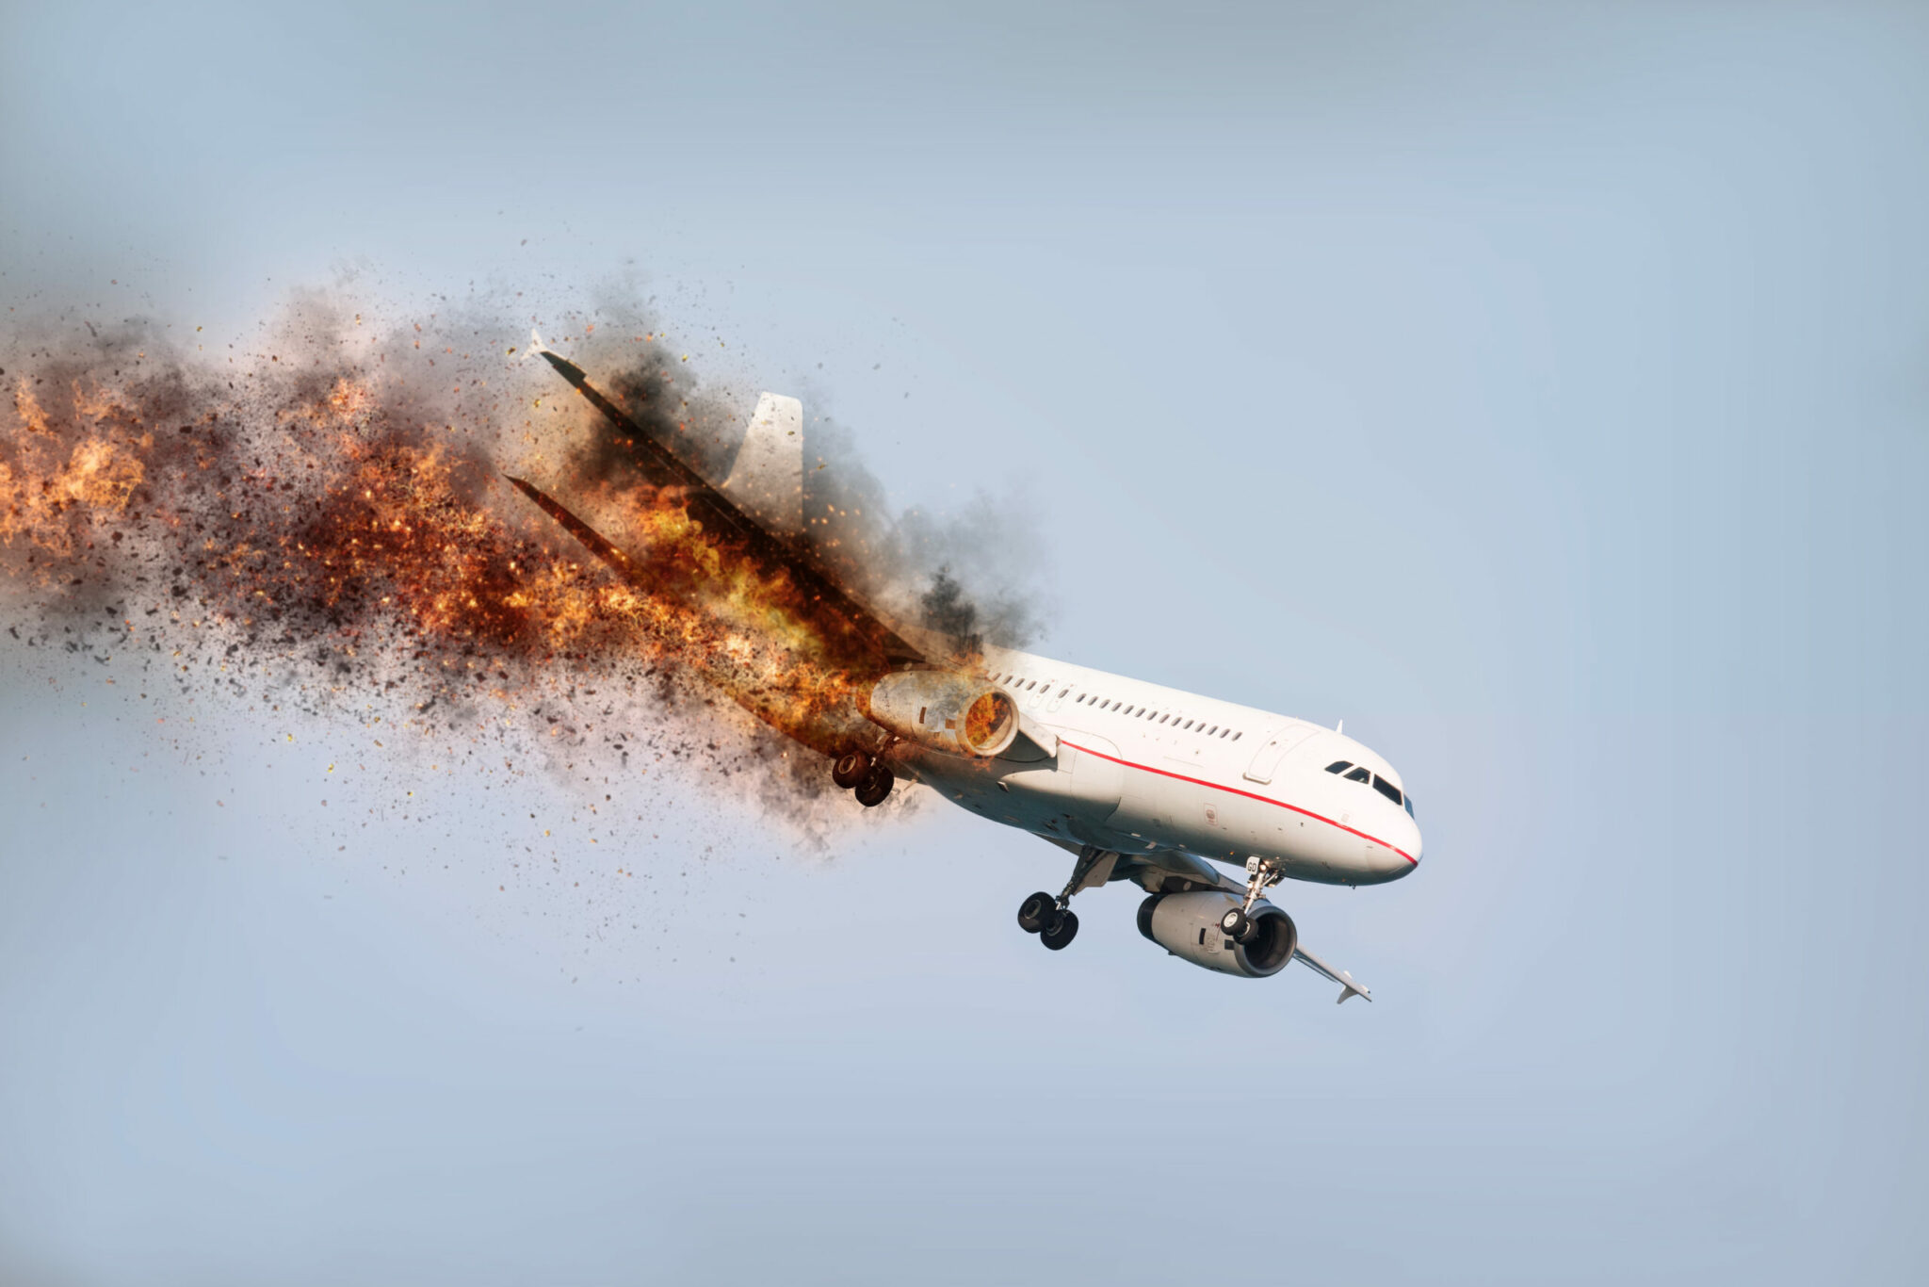
Fire/Smoke
This means when the presence of fire/smoke are inside the aircraft cabin, cockpit, or cargo bay which would result in safety threat

Slide 8
ATM/CNS (Air Traffic Management / Communication, Navigation and Surveillance)
This refers to any incident, accident, or unsafe situation associated with the operation of an aircraft that involves issues with COmmunication, Navigation, Surveillance and Air Traffic Management.
On March 22, 2026 sadly Air Canada(Flight 8646) has encountered with this issue and unfortunately the 2 pilots had died and this inspired me to find a solution to the issue within Aviation despite my lack of knowledge with aviation.

Slide 9
System/Component
Refers to any incident or accident associated with operation of an aircraft caused by failure, malfunction or defect of a specific aircraft system or component.

